Slide 1
CDGC
Databricks Tag Writer
Prototype

Slide 2
What are we trying to do?
Write tags into the Unity Catalog, based on data within the Informatica Catalog
Informatica’s Catalog is very good at classifying the data
Push tags that contain:
Classifications. Rule Base, AI Based, or Manual. It makes no difference. Be able to push all classifications to tags in Databricks.
Business Terms. Push down “business friendly” Terms to the assets in Databricks.
Policies. Push down direct and indirect policies to tags within Databricks.
Also push descriptions to columns and tables
And optionally the link to the informatica Catalog object

Slide 3
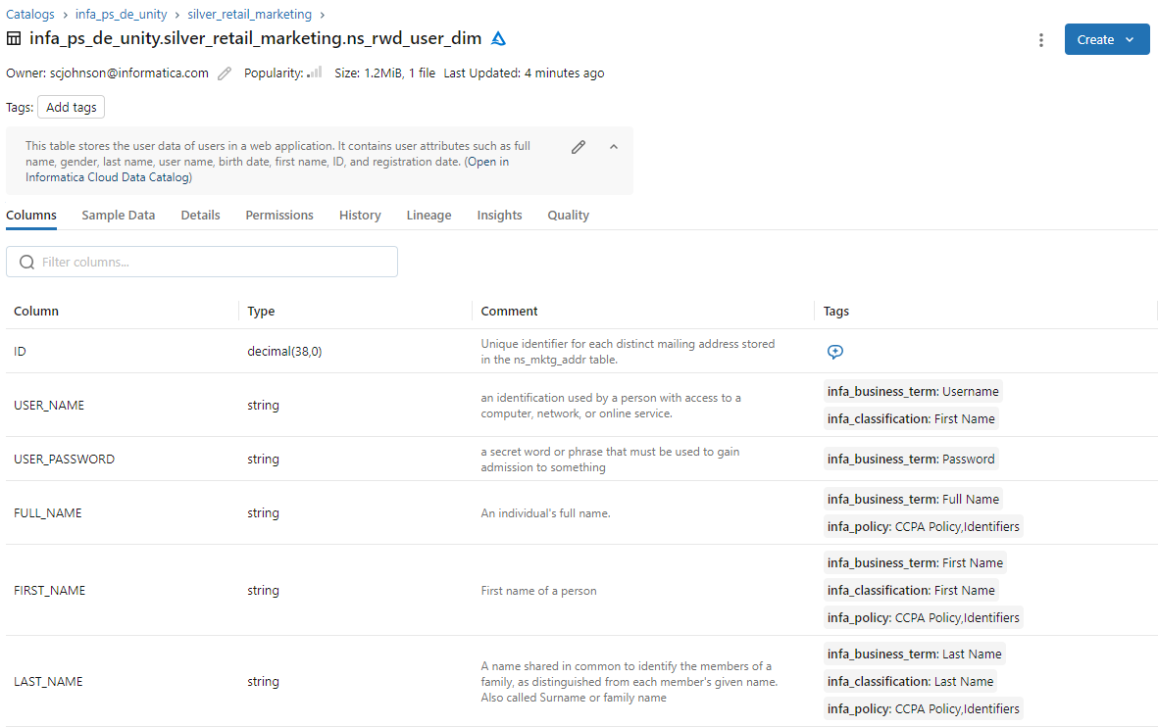
Push Catalog information into Databricks Unity Catalog!
Description of the table, and optionally a link back to the Informatica Catalog
Descriptions of the columns
Tags with:
Glossary Terms
Classifications
Any Policies Related

Slide 4
The approach
Write a Python script that pushes this information to Databricks!

Slide 5
CDGC
Databricks Tag Writer
Prototype
Setup & Running

Slide 6
Setup Step 1
* Only required if using the “py” file. If using Windows, you can skip this step and use the “exe” file.
Using "pip" ensure the required libraries are installed
pip install -r requirements.txt
or
pip3 install -r requirements.txt

Slide 7
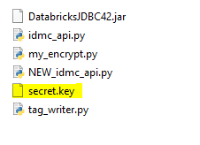
Setup Step 2
Create a secret.key file
python tag_writer.py --generate_key
or
tag_writer.exe --generate_key
* Note this is the keyfile for our encrypted password. If you share this solution, DON’T SHARE THE secrey.key FILE or it is easy to get the password in clear text!

Slide 8
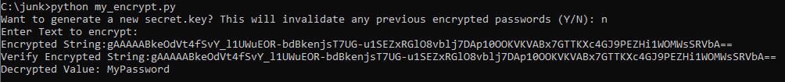
Setup Step 3
Get encrypted passwords by running the python tag_writer.py –encrypt or tag_writer.exe --encrypt
You will be prompted to enter a password in clear text, and be given the encrypted version of that password.
You'll need to do this for the Informatica User's password, and the Databricks user's password (secret token).
Optionally, you can run python tag_writer.py –encrypt or tag_writer.exe –encrypt to verify the password

Slide 9
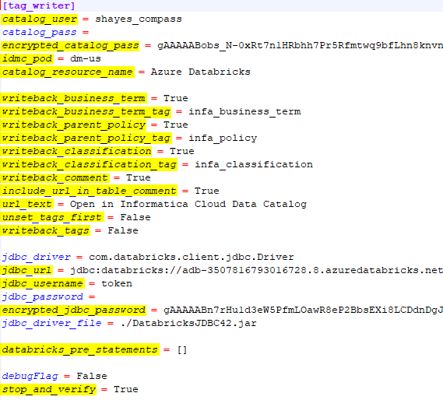
Setup Step 4
Modify the config.ini file and put in your usernames, encrypted passwords, and idmc_pod (Default is the US, change only if in a different region)
Also Specify (as needed):
The name of the Databricks resource that will be evaluated
Whether or not to use business terms, and the name of the existing tag to update
Whether or not to use Policies, and the name of the existing tag to update (will use policies related to the objects, or related to the BT or Classifications related to that object)
Whether or not to use classifications, and the name of the existing tag to update
Whether or not to update comments, and include a link to the Catalog
Option to unset the tags first!
Actually write tags, or just display
JDBC Driver URL, User and Password (encrypted) for Databricks
Any pre statements
Pause before updates

Slide 10

Setup Step 5
This script uses a JDBC connection, so ensure that you have a JAVA_HOME set

Slide 11
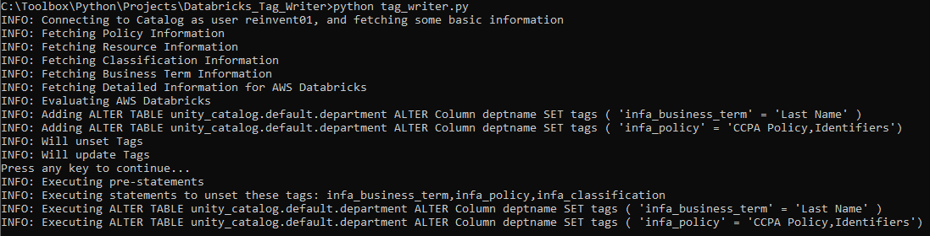
Running
Run the “tag_writer.py" script
python tag_writer.py
or
python3 tag_writer.py
or
tag_writer.exe
The script will connect and evaluate, and prompt if it’s OK to go ahead and actually update the tags. (It will display the actual update statements)

Slide 12
Optional Command Line Arguments
--help
Displays this help message with all command line options.
--catalog_pass
The password for the IDMC Catalog (CDGC) user.
You can provide it as plain text OR as an encrypted value using --encrypted_catalog_pass.
If both are provided, the encrypted password will take precedence.
Example:
--catalog_pass=MySecretPassword
--encrypted_catalog_pass
An encrypted version of the IDMC Catalog (CDGC) password.
* See the Encryption related options to see how to create encrypted passwords
If provided alongside --catalog_pass, this value will be used instead.
The script will decrypt this automatically.
Example:
--encrypted_catalog_pass=gAAAAABobs...

Slide 13
Optional Command Line Arguments (continued)
--catalog_user
The username to connect to the IDMC Catalog (CDGC).
If not specified, the script will look for this in the config.ini file.
Example:
--catalog_user=shayes_compass
--idmc_pod
The IDMC pod identifier to connect to.
If you're unsure of the pod, look at your URL for your login.
It'll be the string just before "informaticacloud.com"
For https://dm-us.informaticacloud.com/identity-service/home it is "dm-us"
Example:
--idmc_pod=dm-us
--catalog_resource_name
Name of the catalog resource within CDGC to target.
Example:
--catalog_resource_name="Azure Databricks"

Slide 14
Optional Command Line Arguments (continued)
--writeback_business_term
Boolean flag (True/False) to enable writing back business term tags.
Do you want it to evaluate Business Terms and write these as tags to Databricks?
Example:
--writeback_business_term=True
--writeback_business_term_tag
The tag name to use when writing back business terms.
What is the name of the Databricks tag to use?
Example:
--writeback_business_term_tag=infa_business_term
--writeback_parent_policy
Boolean flag to enable writing back parent policy tags.
Do you want it to evaluate Policies related to Tables/Views/Columns and write these as tags to Databricks?
Example:
--writeback_parent_policy=True

Slide 15
Optional Command Line Arguments (continued)
--writeback_parent_policy_tag
The tag name to use when writing back parent policies.
What is the name of the Databricks tag to use?
Example:
--writeback_parent_policy_tag=infa_policy
--writeback_classification
Boolean flag to enable writing back classification tags.
Do you want it to evaluate classifications related to Tables/Views/Columns and write these as tags to Databricks?
Example:
--writeback_classification=True
--writeback_classification_tag
The tag name to use when writing back classifications.
What is the name of the Databricks tag to use?
Example:
--writeback_classification_tag=infa_classification

Slide 16
Optional Command Line Arguments (continued)
--writeback_comment
Boolean flag to enable writing back object descriptions as comments.
Do you want it to evaluate Descriptions related to Tables/Views/Columns and write these as comments to Databricks?
Example:
--writeback_comment=True
--include_url_in_table_comment
Boolean flag to include a URL link in the table comment when writing back.
If evaluating comments, do you want to include a URL from the Table/View that points to the table in CDGC?
This is particularly useful if you want your users to see additional information like lineage.
Example:
--include_url_in_table_comment=True

Slide 17
Optional Command Line Arguments (continued)
--url_text
The display text for the URL included in table comments.
If including a URL, What do you want the link text to be displayed in the comment in the Table/View
Example:
--url_text="Open in Informatica Cloud Data Catalog"
--unset_tags_first
Boolean flag to unset existing tags before writing back new ones.
Do you want be to unset these tags, before set them?
This is useful if there may have been objects that got set, prior.
Note it will ONLY effect the tags specified here
(writeback_business_term_tag, writeback_parent_policy_tag, writeback_classification_tag)
Example:
--unset_tags_first=True

Slide 18
Optional Command Line Arguments (continued)
--writeback_tags
Boolean flag to enable writing back tags in general.
Set this to False in order to test what it will do, without performing the update
Example:
--writeback_tags=True
--jdbc_driver
(Databricks JDBC) The fully qualified class name of the JDBC driver to connect to Databricks.
Example:
--jdbc_driver=com.databricks.client.jdbc.Driver
--jdbc_url
(Databricks JDBC) The JDBC connection URL string.
Example:
--jdbc_url="jdbc:databricks://adb-3507816793016728.8.azuredatabricks.net:443/nsen;transportMode=http;ssl=1;AuthMech=3;httpPath=/sql/1.0/endpoints/556b3ac6518656a2;"

Slide 19
Optional Command Line Arguments (continued)
--jdbc_username
(Databricks JDBC) The username for the JDBC connection.
for Databricks, this is usually the string "token"
Example:
--jdbc_username=token
--jdbc_password
(Databricks JDBC) The password for the JDBC connection.
For Databricks, this is typically a token that you can create.
You can provide it as plain text OR use the encrypted version with --encrypted_jdbc_password.
* See the Encryption related options to see how to create encrypted passwords
If both are present, the encrypted password will be used.
Example:
--jdbc_password=MySecretPassword

Slide 20
Optional Command Line Arguments (continued)
--encrypted_jdbc_password
(Databricks JDBC) Encrypted JDBC password.
* See the Encryption related options to see how to create encrypted passwords
If provided alongside --jdbc_password, this value will be used instead.
The script will decrypt it automatically.
Example:
--encrypted_jdbc_password=gAAAAABn7rHu...
--jdbc_driver_file
(Databricks JDBC) File path to the JDBC driver JAR file.
You can specify just a filename (which it will expect in the same directory as the python script,
or you can specify a full path to where the jar file resides.
Example:
--jdbc_driver_file=./DatabricksJDBC42.jar
--databricks_pre_statements
(Databricks) List of SQL statements to execute prior to main operations.
Example:
--databricks_pre_statements=["SET spark.sql.shuffle.partitions=10"]

Slide 21
Optional Command Line Arguments (continued)
--debugFlag
Boolean flag to enable debug mode with verbose output.
Example:
--debugFlag=False
--stop_and_verify
Boolean flag to pause execution for manual verification steps.
Example:
--stop_and_verify=True

Slide 22
Optional Command Line Arguments (continued)
Encryption related options:
--encrypt
Prompts to enter a plain text password and outputs its encrypted form.
Useful for generating encrypted passwords for config or command line use.
--decrypt
Prompts to enter encrypted text and outputs the decrypted plain text.
Use this to verify that encrypted passwords were copied correctly.
--generate_key
Generates a new secret key file (secret.key) used as the basis for encryption and decryption.
If you generate a new secrety.key, any previous encrypted passwords will be invalidated.
Note: This encryption is intended to obscure passwords, not provide strong cryptographic security.

Slide 23
Thank You
Questions / Issues / Suggestions:
Scott Hayes
shayes@informatica.com

